Slide 1
Concrete strength Project
Arshdeep Singh

Slide 2
Data
Response variable is concrete strength.
Input variables are cement, blast furnace slag, fly ash, water, superplasticizer, coarse aggregate, and fine aggregate, age.
Size of data is 1030
Dummy variable needed to transform age from 1 year to quarter system

Slide 3
motive
Goal, We want to figure out how concrete is affected by different variables, we can then find out how to create better and stronger concrete.
Method, We will run models to find out the effects of different variables so we can determine what is the best mix for concrete strength

Slide 4
Exploratory stage
Using histograms, descriptive statistics , Correlation matrix, correlation tables, we can look at the data in a different and more digestible way.
Use tools to fix data, create cleaner data

Slide 5
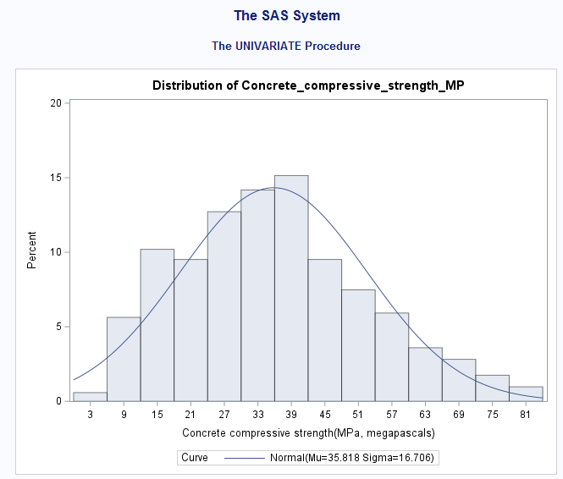
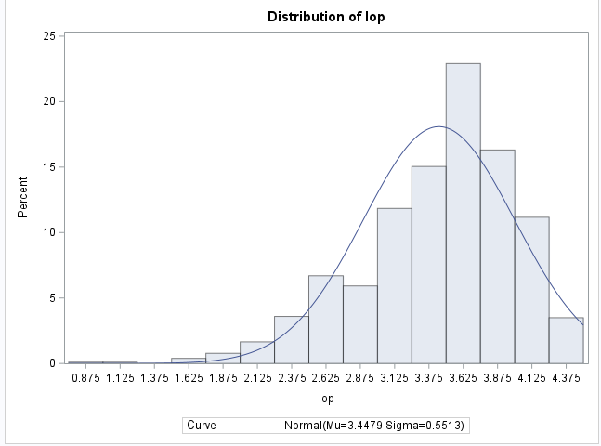
Exploratory stage
Response variable histogram showing slight skewness
Transformed variable is very skewed, and not showing normality.
Histograms
We can use histograms to analyze our data’s normality and determine if we need to transform variables.

Slide 6
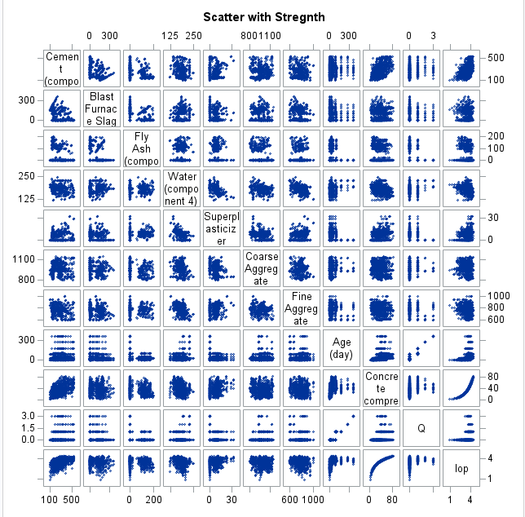
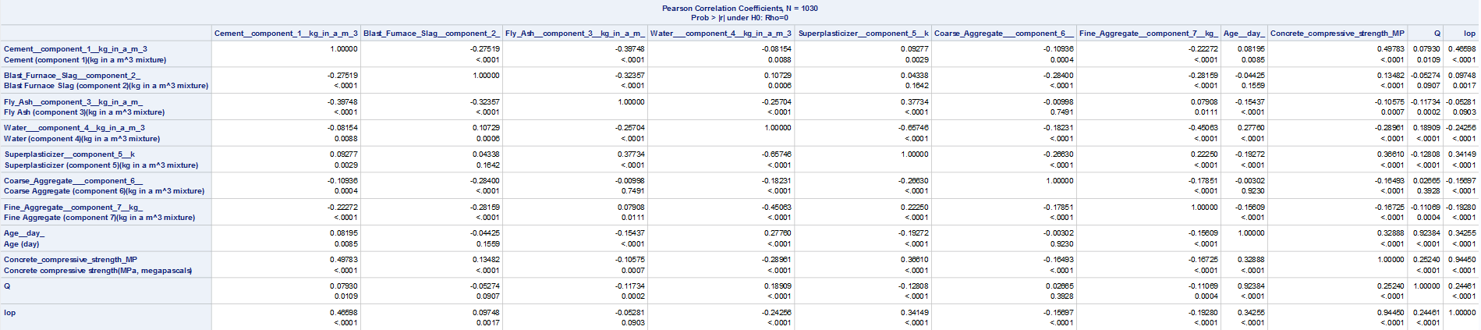
Exploratory stage
No linear relationship being shown in scatterplot matrix
Low correlation values in correlation table showing lack of linear relationship
Correlation analysis
We use correlation tables to show the correlation values and Correlation matrices to visualize the correlation between variables. Correlation near 1 means strong, .5 means moderate, and near zero mean weak.

Slide 7
Exploratory stage
The transformation that was done was the splitting up of age, split age up into 4 quarters instead of the 365-day format.
The interaction variables set up are between water and Coarse aggerate, and water and water and fine aggregate
Interaction variables have insufficient P-vals, removed from model and proved useless
Transformations, Interaction variables
We use transformations to fix certain issues with data, we can split data using dummy variables or scale them using a transformation method. Interaction variables are a combination of two variables that give us deeper insight on the interaction of variables in the data set.

Slide 8
Model
Use selection methods to find significant predictors
Use VIF model to check for Multicollinearity
Use regression model to find influential points and outliers
Regression used for model assumptions
Training and testing model
Comparing models

Slide 9
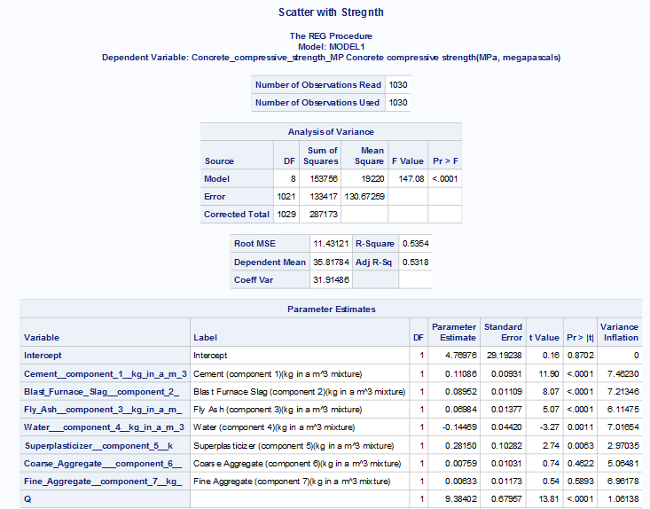
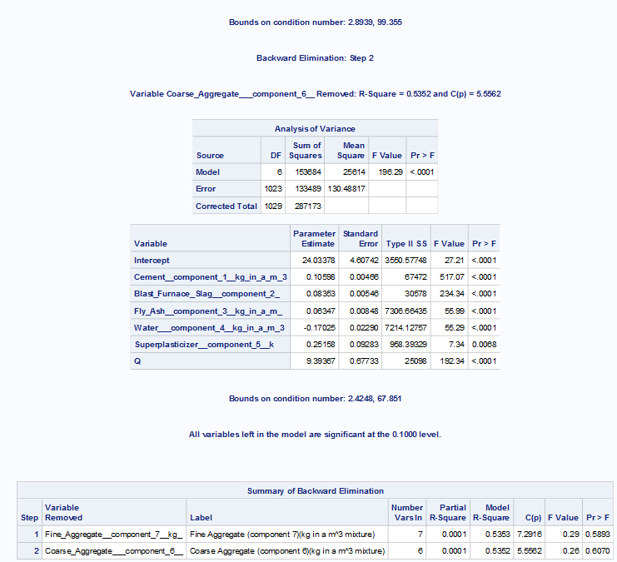
Model
Selection method used was backward selection
Selection method removed Coarse aggregate and fine aggregate
No signs of multicollinearity as VIF is under 10
Selection method and VIF
We use selection methods to find the model with significant predictors, and we use VIF model to find variables that are causing multicollinearity.

Slide 10
MODEL
Only removed points that are both influential and outliers
One point found at OBS 382, and removed
Influential points and outliers
Influential points are points that heavily effect the slope of the equation of the model. Outliers are points that are far away from the normal data points.

Slide 11
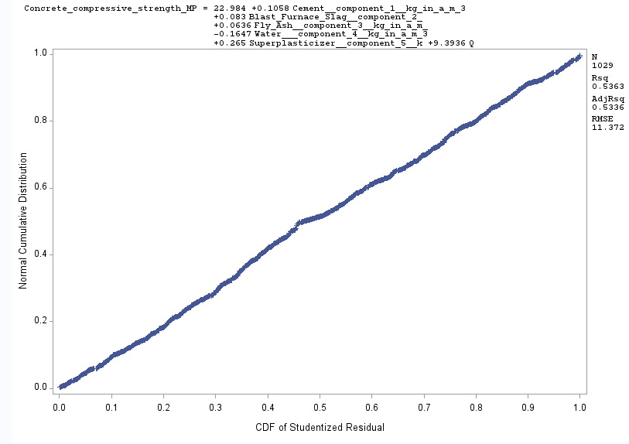
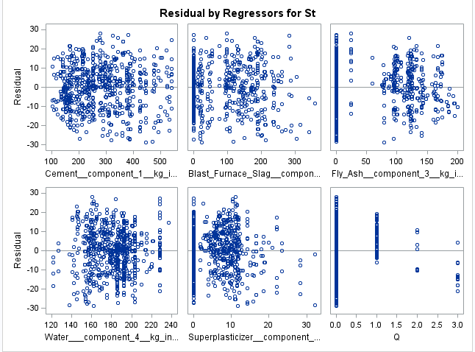
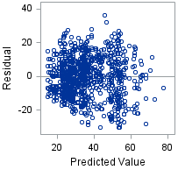
Model
Linearity assumptions is violated(via correlation matrix)
Independent assumption is violated
Constant variance assumption is violated
Normality assumption is violated
Model assumptions
Model assumptions are used to validate and show the reliability of the model. The assumptions are Normality, independent, constant variance, and linearity.

Slide 12
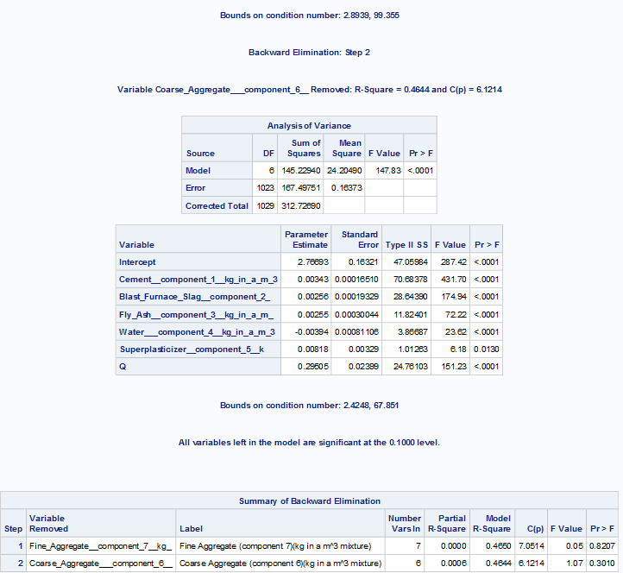
Model
Transformed variable model showed lower ADJR^2
Different selection method on response variable gave same predictor variables and same ADJR^2
Variables Fine aggregate and coarse aggerate removed
Removing variables manually based on cut off of .05 P-Vals lead to same variables removed.
Comparing models
By comparing different models, we can verify we have a good model. We can compare a few different ways that make sense, like transformation of variables, or selection method.

Slide 13
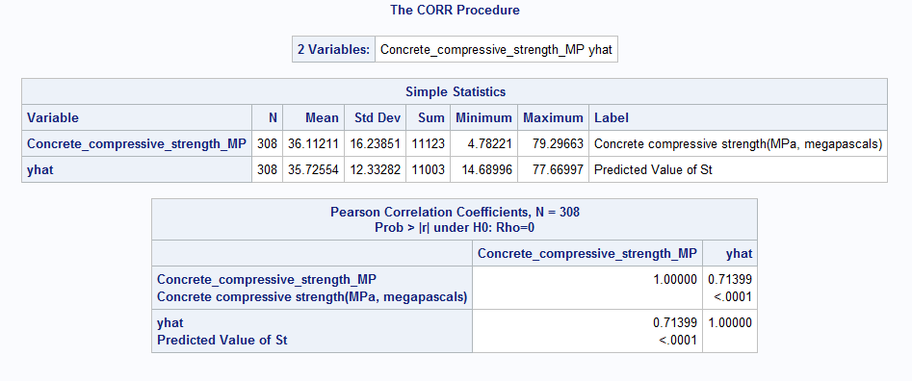
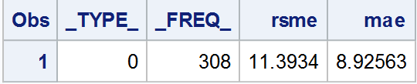
Model
Used a 70/30 split, with 70% of data being for training, and 30% for testing
We have a correlation value of .71, which means decent model but not the best
308 OBS in testing and 722 in training
RMSE is at 11.39, showing high error
Training and testing model
We can train a model by first splitting the data set up and assign apart of the data to training and apart of it to test the model. This can help us access our model's accuracy. The correlation refers to the response variable correlation to the trained response variable YHAT

Slide 14
Final model
The final model equation is was Concrete strength = 22.98+.11(Concrete Compound KG) +.083(Blast furnace slag) +.064(Fly Ash) =.165(Water) +.265(Superplasticizer) +9.39(Q)
ADJR^2 is at .53
F-Val of 147 at significant P val

Slide 15
Model improvements
This model can be improved in a few ways, we don’t have the best ADJR^2 and our training model doesn’t have the best correlation value.
Potentially improvements
More Raw data for training model
Improved dummy variable for age
Model assumptions need to be fixed

